Slide 1

A Case for Adobe InDesign as Tech Writing Tool
Who knew?
FINAL PROJECT—Rebecca K. Lewis

Slide 2
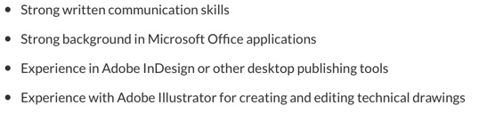

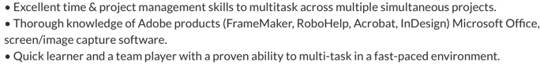
Why
???
Look at these
TECH WRITING JOB ADS!

Slide 3



But FIRST: Let’s look at Adobe FrameMaker?
Industry Standard at least since the 1990s.
Tech Writing Software.
Apparently user friendly??
Can import from other doc types.

Slide 4
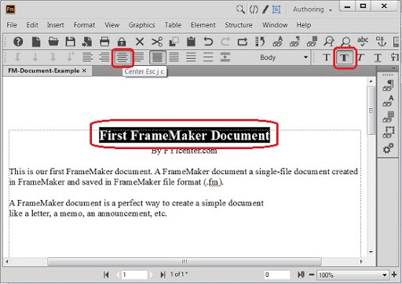
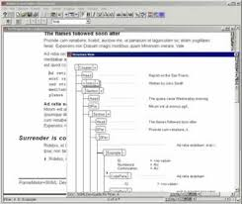
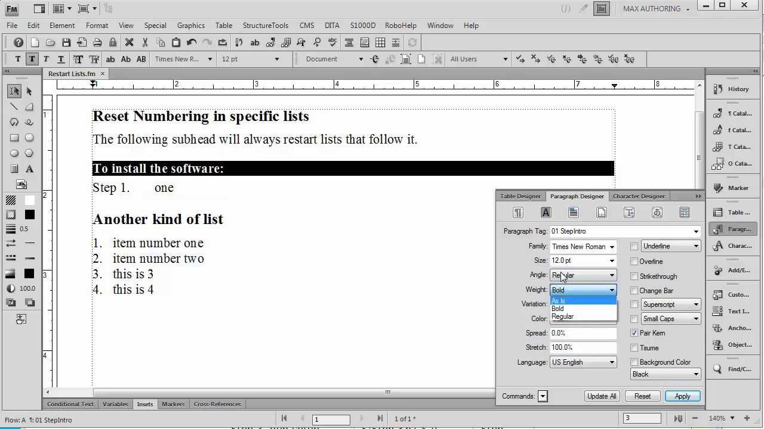

But What About This?
Not visually appealing. Very dated-looking interface for an “updated” software. Can be a little clunky.

Slide 5
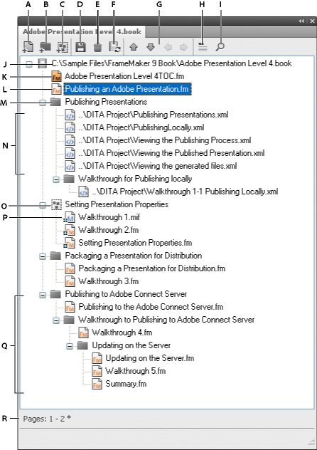
Also this!
FrameMaker Book File interface does not look like a book to me, a visual learner.
Is there a different way to view this?

Slide 6
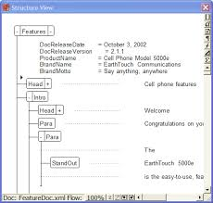
And THIS TOO!
WRITING OR VIEWING A DOCUMENT IN A MARKUP LANGUAGE OR STRUCTURE CAN BE
CONFUSING
AND EVEN
DAUNTING

Slide 7


And AWFUL NEWS!
YOU STILL CAN’T RUN FRAMEMAKER ON A MAC???
It’s not cloud-based.
Must have Windows to operate it, unless you get some funny software…
This Photo by Uown Author is licensed under CC BY

Slide 8

Ok, now for InDesign… WARNING: I do not know everything about it!
A learning curve, especially for those unfamiliar with Adobe products. I had no training on it.
Not “tech writing software,” necessarily.
But why not? Too visual?
Short docs only?
Can you import/export different kinds of documents?

Slide 9
THINGS YOU CAN CREATE WITH ADOBE INDESIGN:
Magazine articles
Brochures
Menus
Textbooks (Up to 9,999 pages!)
Manuscripts/Rough Drafts
Templates for many more ideas!

Slide 10

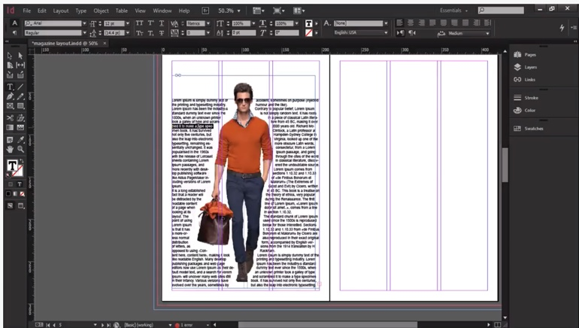
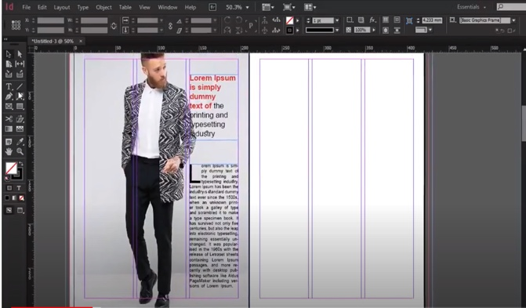
Magazines:

Slide 11
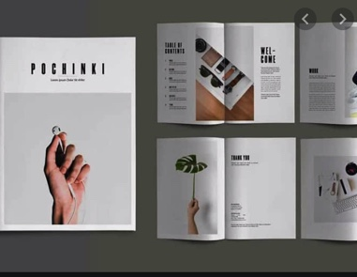

Other things:
Brochures!

Slide 12
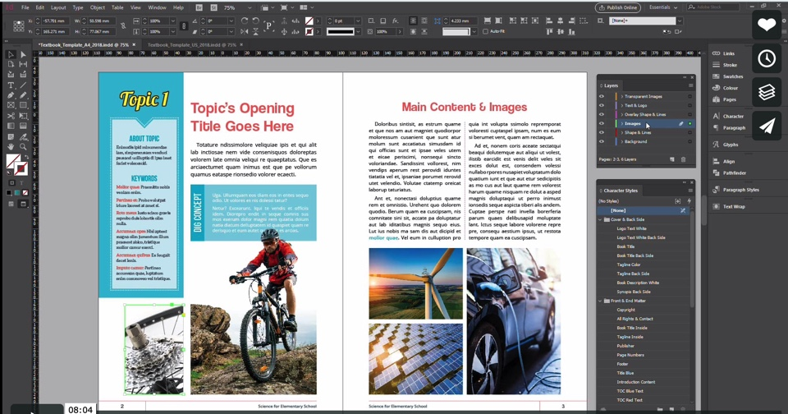



Textbooks, Regular Books, User Guides, etc!

Slide 13
What you can IMPORT into InDesign:
Word Files (using “placing”)
PDFs (ditto, but doesn’t allow editing without a third-party plug-in)
XML files
HTML, yes-but indirectly-must use XML format
Jpg and png files (best suited!)

Slide 14
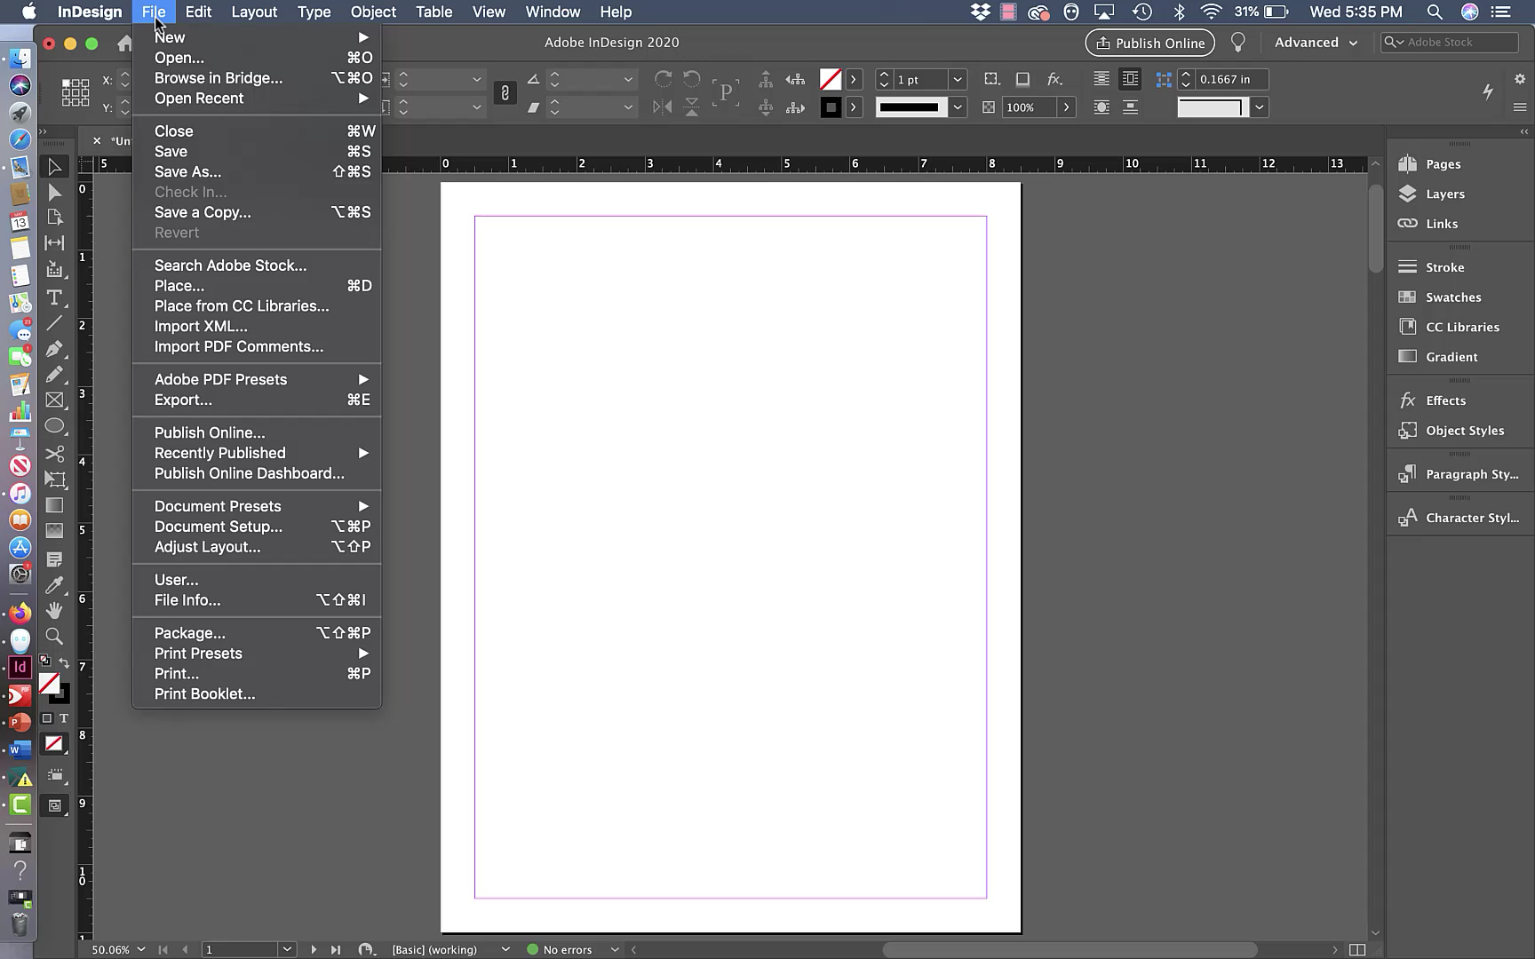
What can you EXPORT using InDesign?
EXPORT OPTIONS:
Adobe PDF, EPUBs, HTML, InDesign Markup, JPEGs, PNGs, XMLs

Slide 15

How to Create a BookFile in InDesign:

Slide 16

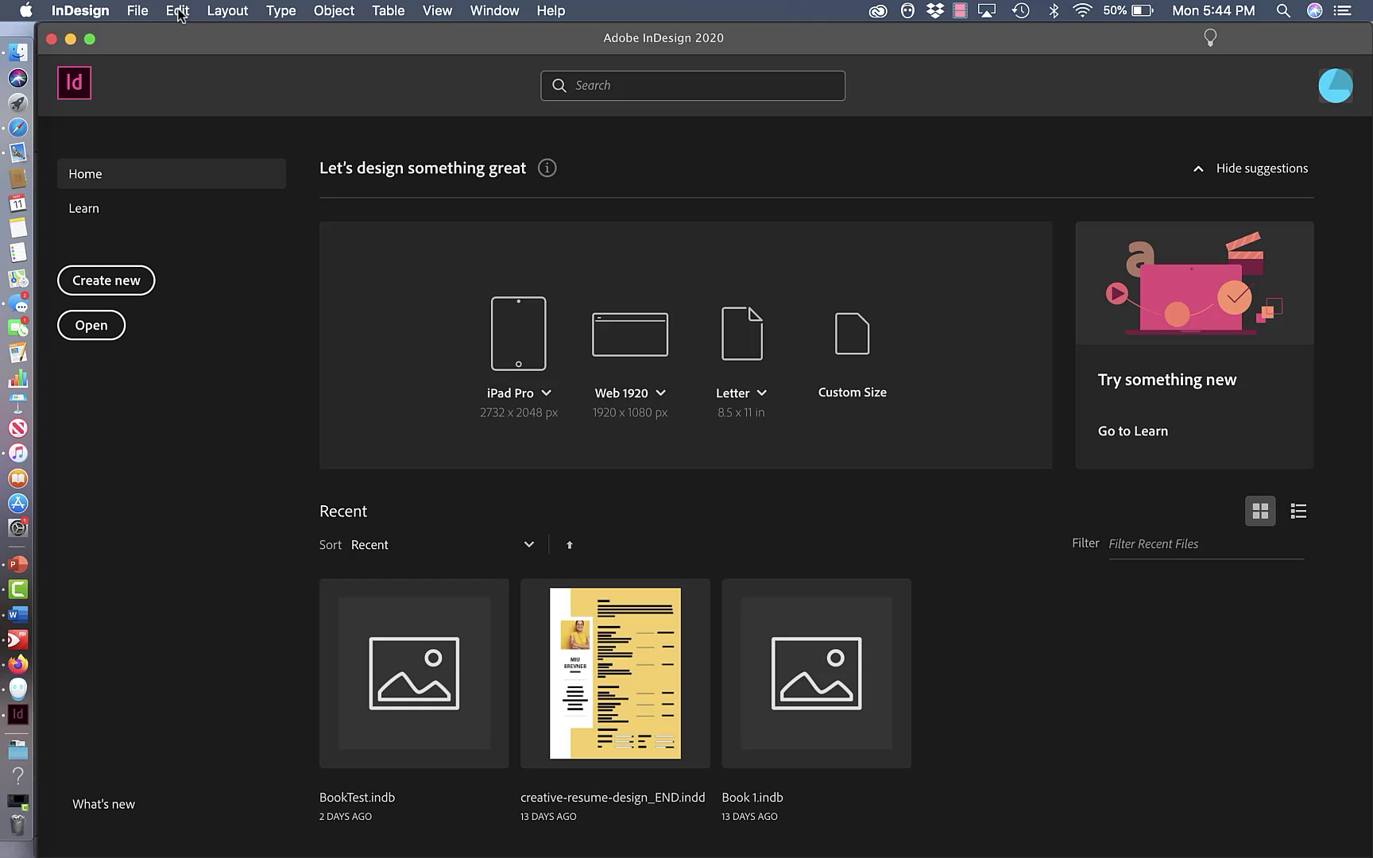



Slide 17

How to “EXPORT” a Microsoft File to InDesign using “Placing.”

Slide 18
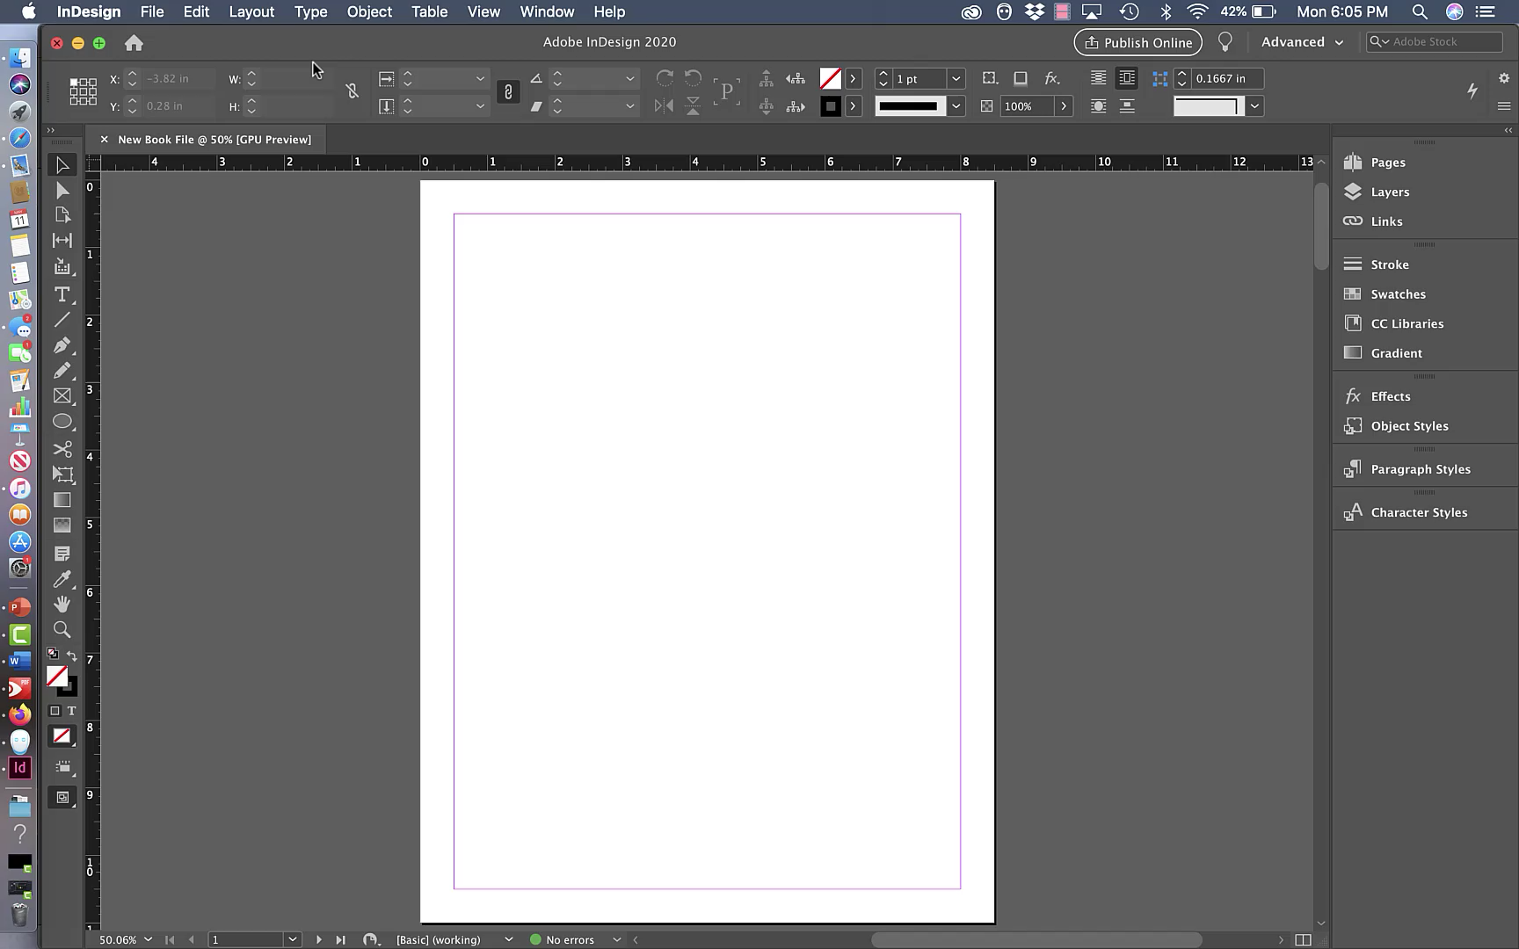

Slide 19

How to Insert a Picture in InDesign using “Placing."

Slide 20
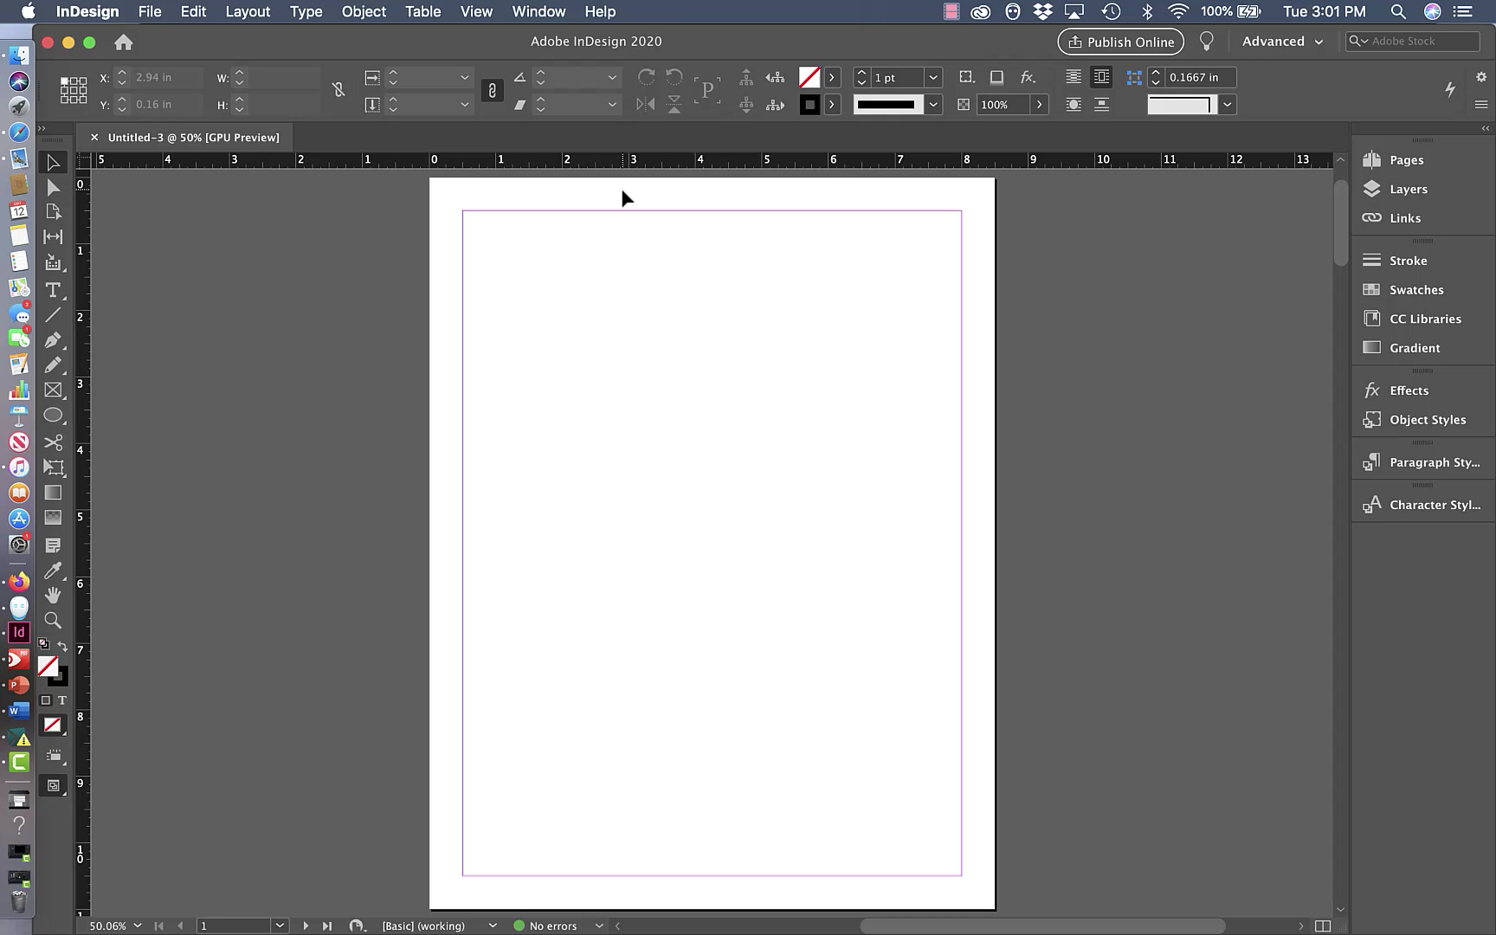

Slide 21
Why add InDesign to course toolkit?
Good for visual learners and artistic/creative types.
Cost effective! Students get the whole Adobe CC for $19 a month! If InDesign can’t do it, another app in the Creative Cloud certainly can!
FrameMaker stands alone…
Good for folks who don’t think primarily in terms of XML or HTML
So many things it can do!!
JOB ADS!!!
Runs on Mac!

Slide 22
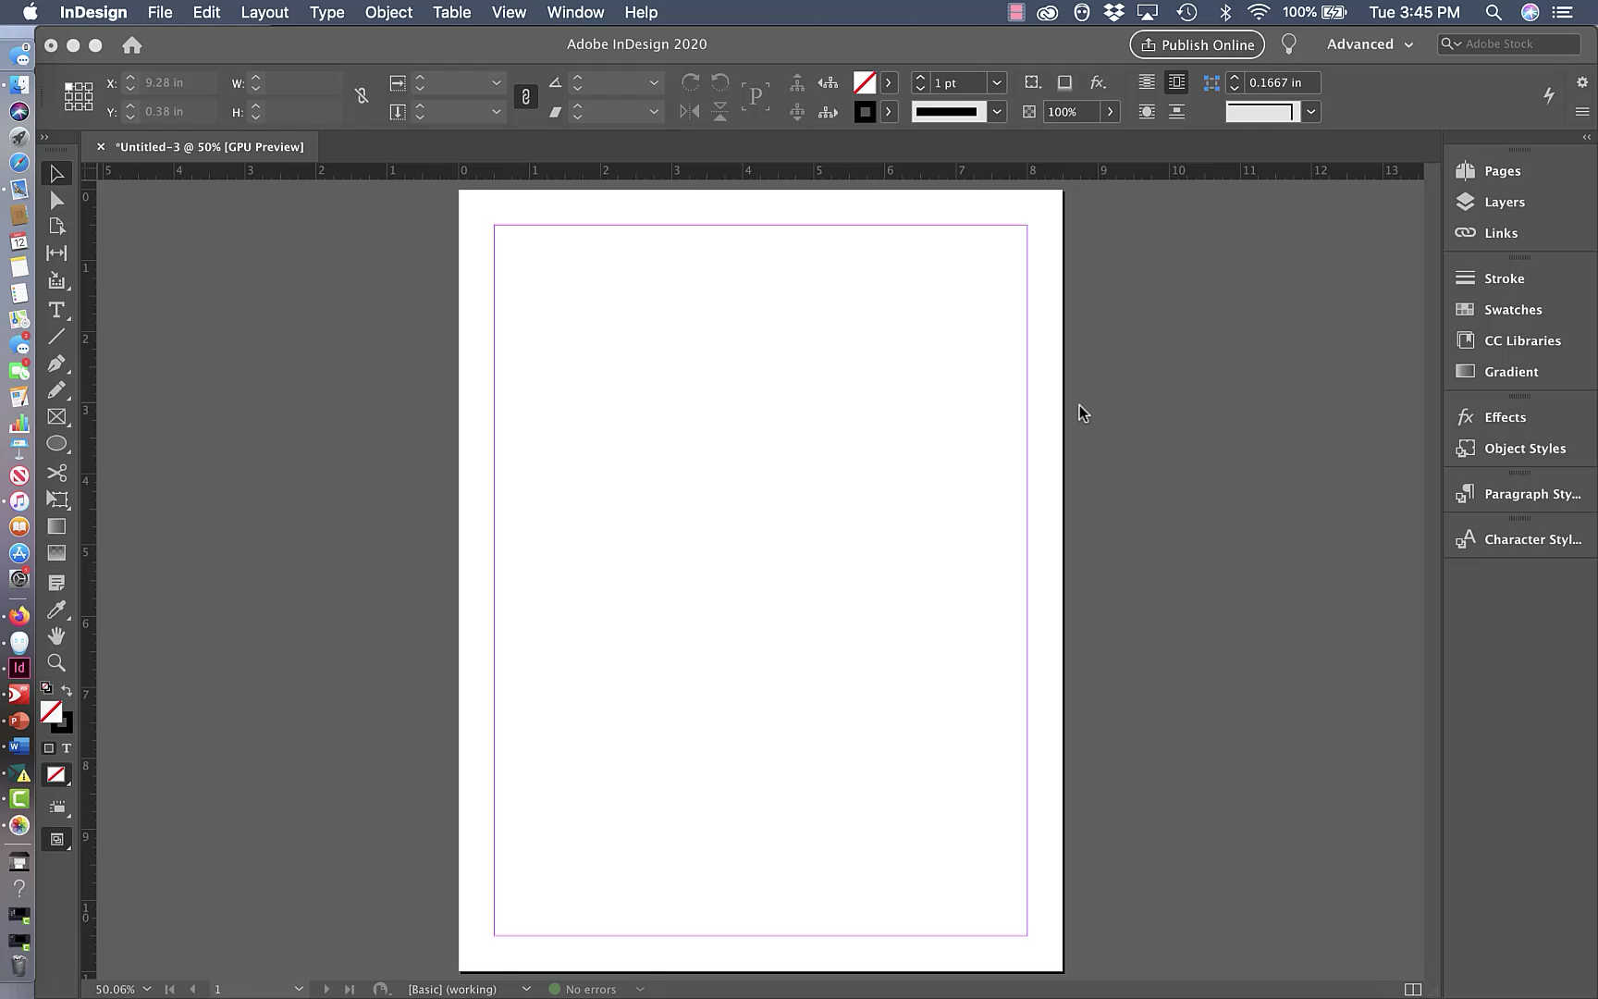

Resources everywhere!
Because of its popularity, tutorials can be found all over
Under the lightbulb icon.
YouTube videos.
Web tutorials
PDF guides

Slide 23
ANY QUESTIONS OR COMMENTS?
DID I MISS ANYTHING?

